Slide 1
What do women want?
THE RIGHT TO VOTE!

Slide 2
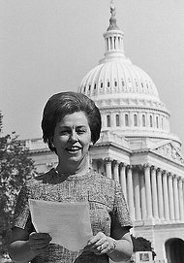
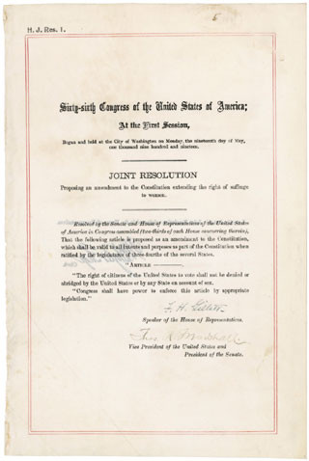
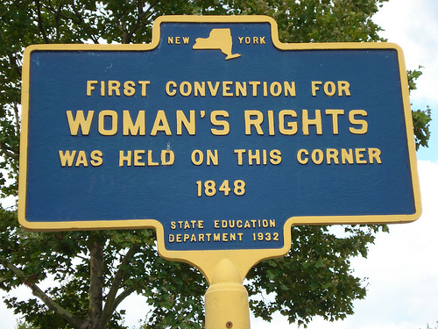
“In any moment of decision, the best thing you can do is the right thing, the next best thing is the wrong thing, and the worst thing you can do is nothing.” –Teddy Roosevelt
1848: The first Women’s Rights Convention was held in Seneca, NY at the Wesleyan Chapel Church by Elizabeth Cady Stanton and Susan B. Anthony
1878: The first Woman Suffrage Amendment was introduced to the U.S. Congress
1920: 19th Amendment passed granting women the right to vote

Slide 3
“A vote is like a rifle; its usefulness depends upon the character of the user.” –Teddy Roosevelt
Jeanette Rankin of Montana was the first female to become elected as a political leader. Her role in the U.S. House of Representatives showed a continual record of voting against war. She stated in 1916 when she was elected, “I may be the first woman member of Congress, but I won’t be the last.” She also said, “If I am remembered for no other act, I want to be remembered as the only woman who ever voted to give women the right to vote.” Rankin was a representation of the Democratic Party.

