Slide 1
What do women want?
THE RIGHT TO VOTE!

Slide 2
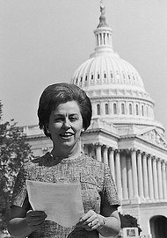
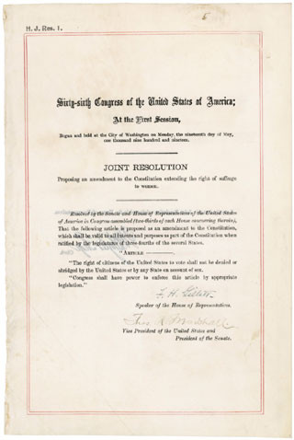
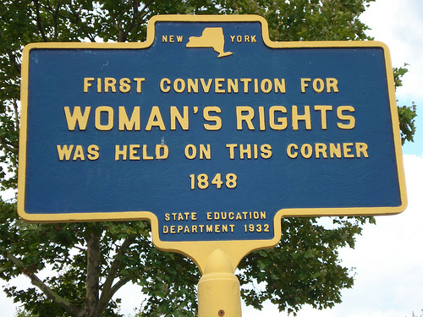
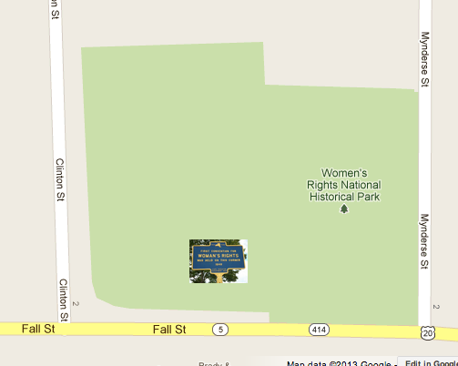
“In any moment of decision, the best thing you can do is the right thing, the next best thing is the wrong thing, and the worst thing you can do is nothing.” –Teddy Roosevelt
1848: The first Women’s Rights Convention was held in Seneca, NY at the Wesleyan Chapel Church by Elizabeth Cady Stanton and Susan B. Anthony
1878: The first Woman Suffrage Amendment was introduced to the U.S. Congress
1920: 19th Amendment passed granting women the right to vote

Slide 3
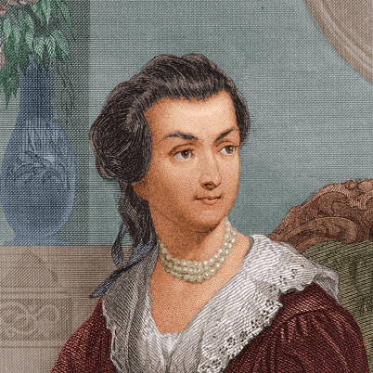
From Abigail Adams writing to her husband in 1776 to mention the inclusion of females in the Declaration of Independence and him writing back to her telling her “all men are created equal” sarcastically.. To the first location on 126 Fall Street in Seneca, NY in 1848 for the First Women’s Rights Convention

